Slide 1
ONLINE CUSTOMER JOURNEY

Slide 2
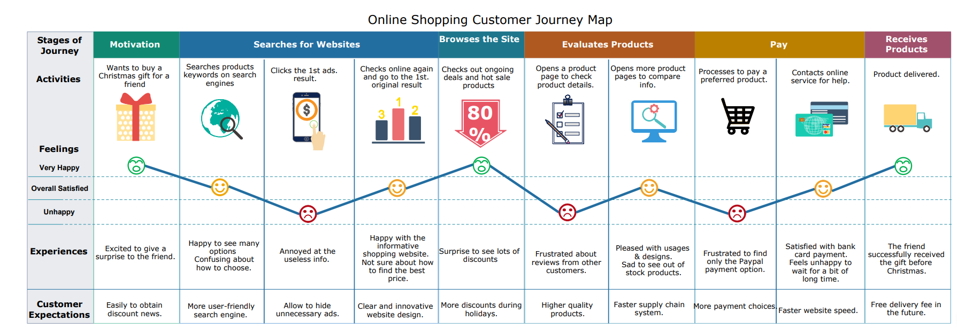
INTRODUCTION

Slide 3

PROBLEM STATEMENT
The data from GfK (Growth for Knowledge), a German market research company which is among the four biggest worldwide.
This data contain series of various touchpoints, as well as consumer characteristics. Therefore, when the term conversion is used, it will be referred to travel bookings.
Our main focus is on “How do different consumer segments behave when they come across various touchpoints?”
Also predict whether the transaction will be converted to purchase or not.

Slide 4
DATASET
The data is event-based and is gathered by GfK Crossmedia link.
The observation period is from June 1, 2015 to September 32, 2016 and contains in general, 12252 consumer journeys, 3674 total bookings of which 192 are the focal’s brand.
We have the following features:
Target Variable
Purchase_status (based on purchase_own and purchase_any)_
0 - 0 customer own touchpoint purchase has hapended
1 - 1 firm's touchpoint purchase has happened from where customer started journey
0 - 1 competitor firm's website purchase has happened

Slide 5
EXPLORATORY DATA ANALYSIS

Slide 6
FIC and CIC
A touchpoint refers to “a customer contact point, or a medium through which the firm and the customer interact”. Various researchers have divided the touchpoints into two basic categories: The customer-initiated or customer-owned contacts (CIC) and the firm-initiated or brand-owned contacts (FIC).
A customer-initiated contact, by definition, is a contact that is initiated by a customer.
a firm-initiated contact is any touch point that results from a company’s initiative and usually is also managed by it.

Slide 7
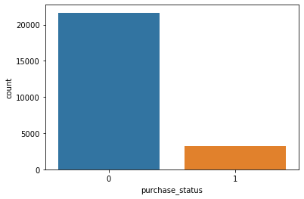
TARGET VARIBLE- PURCHASE_STATUS
The target variable purchase_status is whether the purchase was customer initiated or firm initiated.
0 represents CIC
1 represents FIC

Slide 8
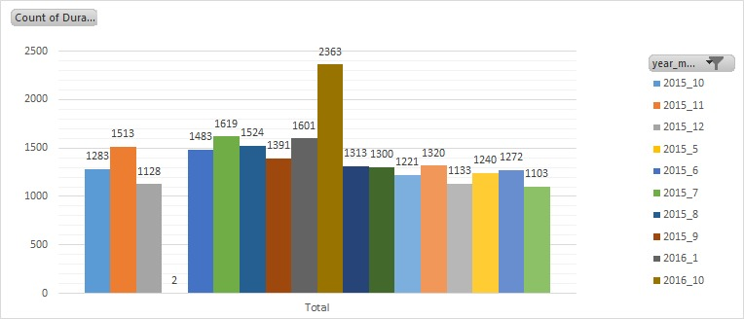
DURATION IN EACH MONTH OF AN YEAR
Duration: seconds spend on a touchpoint (capped at 720 seconds)

Slide 9
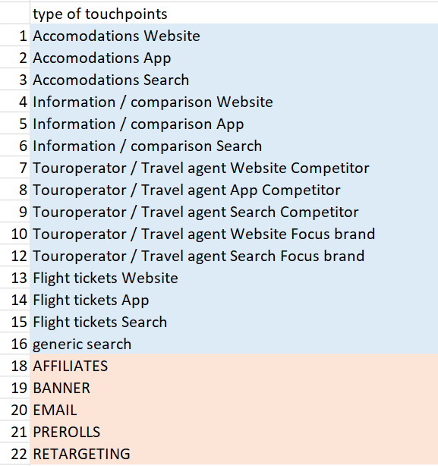
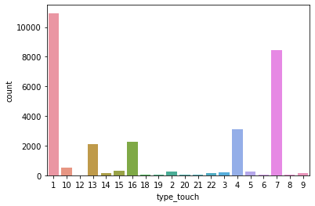
NUMBER OF CONSUMERS AT EACH TOUCH-POINT

Slide 10
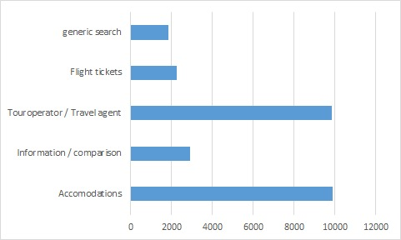
TYPE OF CONSUMER INITIATED TOCH-POINTS
Tour operator and accommodation are major touchpoints.
It includes website, app and tool searches within as well

Slide 11
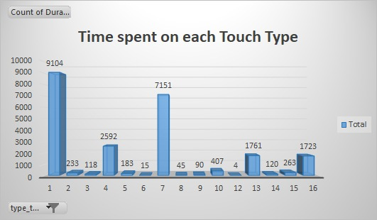
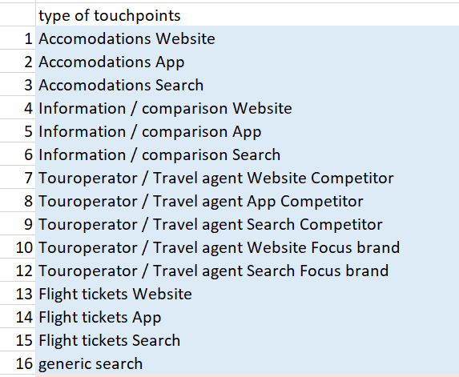
TIME SPENT ON EACH TOUCH TYPE (CONSUMER INITIATED ONLY)

Slide 12
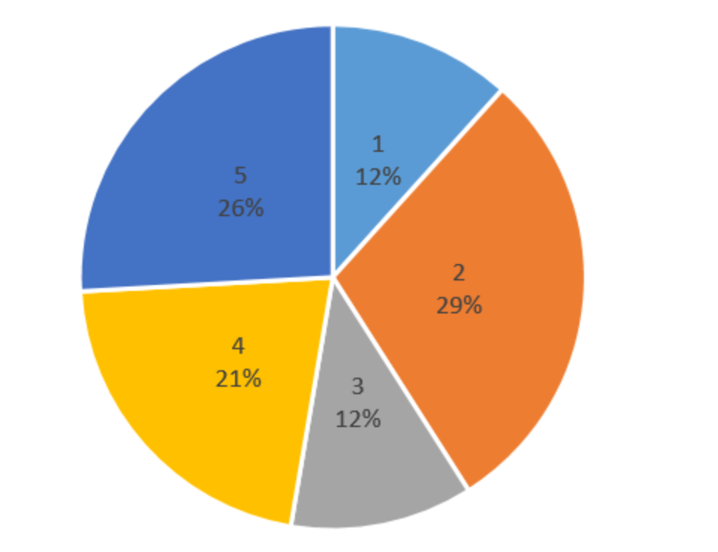
DISTRIBUTION OF PURCHASES FROM EACH REGION
SPSS_Regio5 : Region
1: Amsterdam, Rotterdam, Den Haag
2: West (1 excluded)
3: North
4: East
5: South

Slide 13
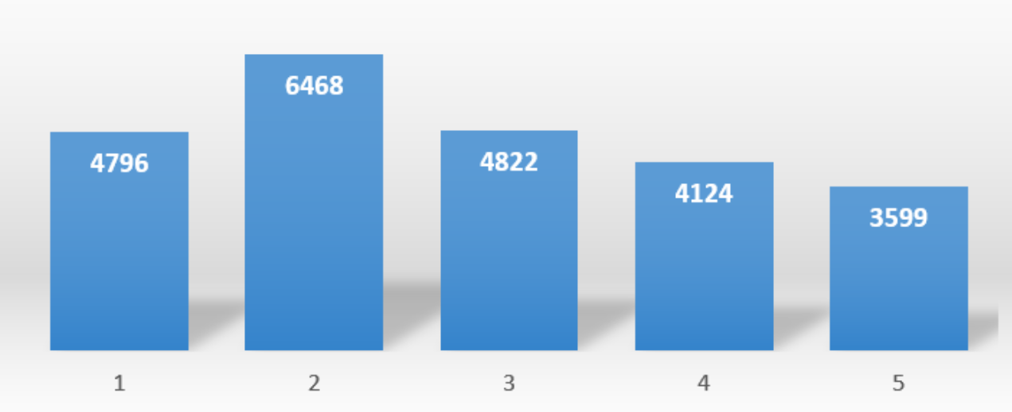
SOCIAL CLASS DISTRIBUTION
AFG_sk2015: Social class
1: a
2: b1
3: b2
4: c
5: d

Slide 14
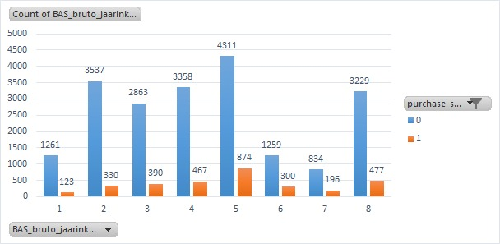
GrossIncome based chart
BAS_bruto_jaarinkomen : Gross income (year)
1: <€12.900 (minimum)
2: €12.900<=27.000 (below average)
3: €27.000<=33.500 (almost average)
4: €33.500<=40.000 (average)
5: €40.000<=67.000 (between 1 and 2 times average)
6: €67.000<=79.900 (2 times average)
7: >79.900 (above 2 times average)
8: don't know / don't want to say

Slide 15
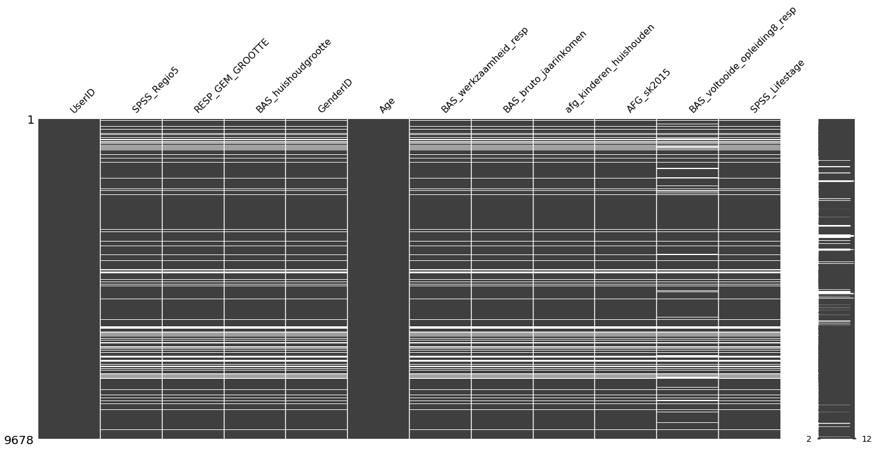
A view of missing values in TravelDataDemos

Slide 16
STATISTICAL MODELS USED FOR FEATURE SELECTION
Purchase_status as CIC and FIC being classification category.
All the numerical and categorical variables are tested for relation with the target variable and only relevant one are considered for model building.

Slide 17
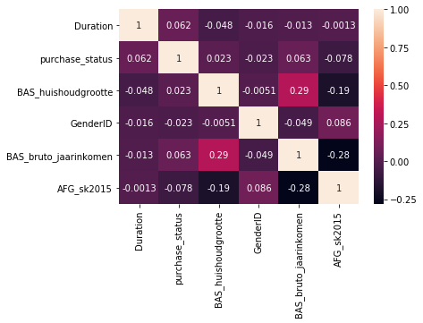
CORRELATION BETWEEN VARIBLES

Slide 18
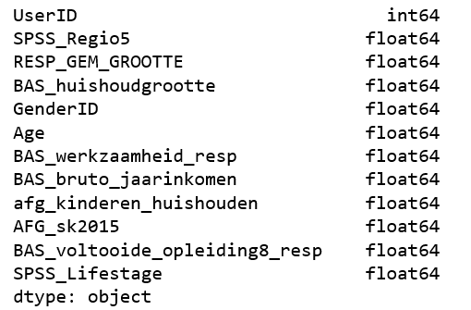
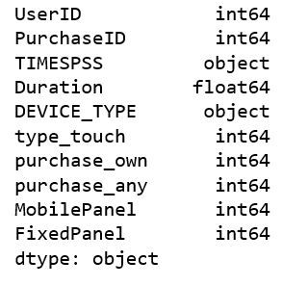
ABOUT DATASET DF1 AND DF2
TravelDataDemos dtypes
TravelData dtypes

Slide 19
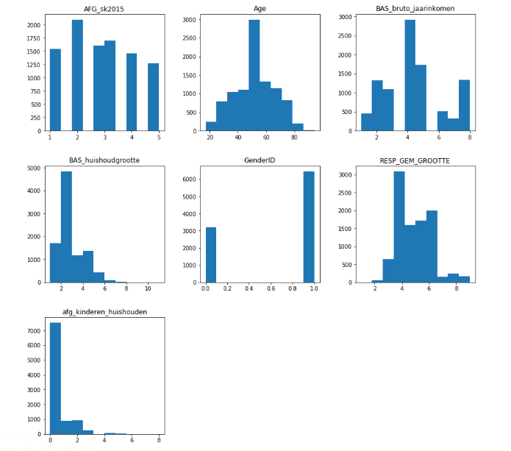
Numerical Variable Analysis for TravelDemos Data
SPSS_Regio5 : Region
Age: Age
BAS_bruto_jaarinkomen: Gross income (year)
BAS_huishoudgrootte: Household size (Number of persons)
GenderID: Gender
RESP_GEM_GROOTTE: Size of manucipality
afg_kinderen_huishouden:number of children in household

Slide 20
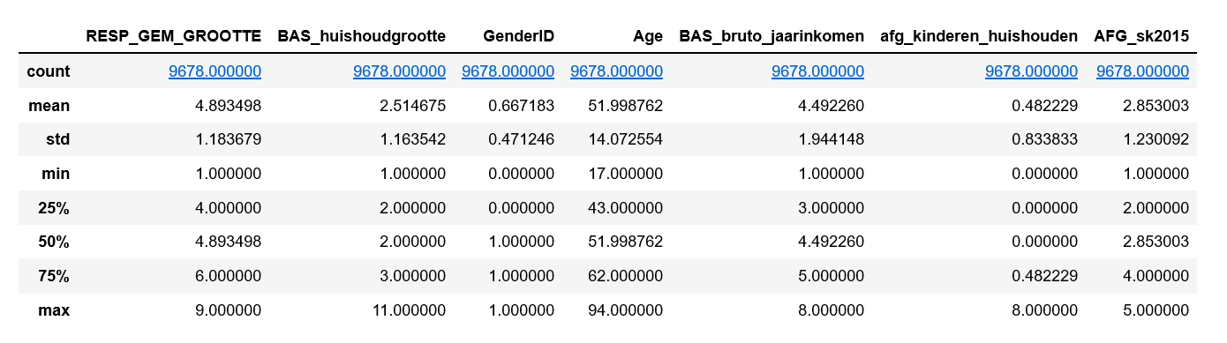
Summary
Here we can look at the summary statistics of TravelDataDemos.
We get an idea about each column by looking at their minimum and maximum

Slide 21
MODEL BUILDING

Slide 22
OVERALL PERFORMANCE OF MODELS ON ONLINE CUSTOMER JOURNEY
Models were applied on data obtained after cleaning
MODEL | DECISION TREE | BAGGING | RANDOM FOREST | ADA BOOSTING | XGBOOST | GRADIENT BOOSTING
ACCURACY SCORE | 87.05% | 84.93% | 84.21% | 87.05% | 87.05% | 87.05%

Slide 23
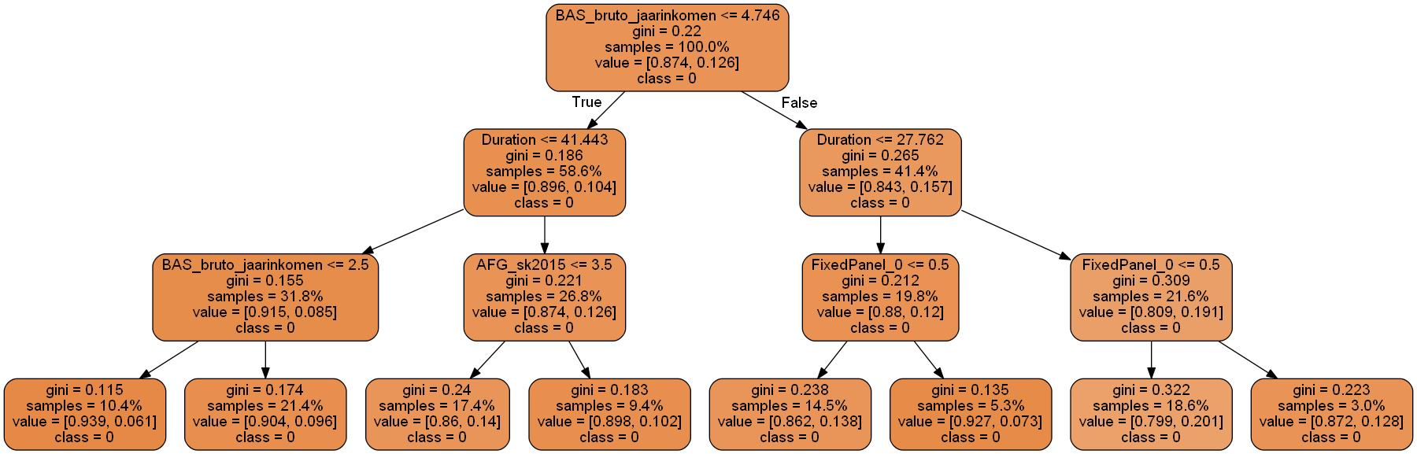
DECISION TREE
Imbalanced Decision tree

Slide 24
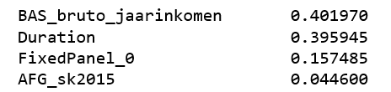
LIST OF FEATURE IMPORTANCE
German version
Gross annual Income
Duration
number of months (laptop)
Social Class
English version

Slide 25
Over Sampling & Under Sampling
Over sampling and under sampling are techniques used in data mining and data analytics to modify unequal data classes to create balanced data sets.
When one class of data is the underrepresented minority class in the data sample, over sampling techniques maybe used to duplicate these results for a more balanced amount of positive results in training. Over sampling is used when the amount of data collected is insufficient.
Conversely, if a class of data is the overrepresented majority class, under sampling may be used to balance it with the minority class. Under sampling is used when the amount of collected data is sufficient.

Slide 26
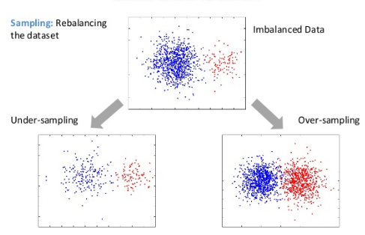
About over sampling
Why we used Over Sampling?
0 - 87% (CIC)
1 - 12%(FIC)

Slide 27
Model Accuracy
Only two models gave better results
MODEL | BAGGING | RANDOM FOREST
ACCURACY SCORE | 94.307% | 94.36%

Slide 28
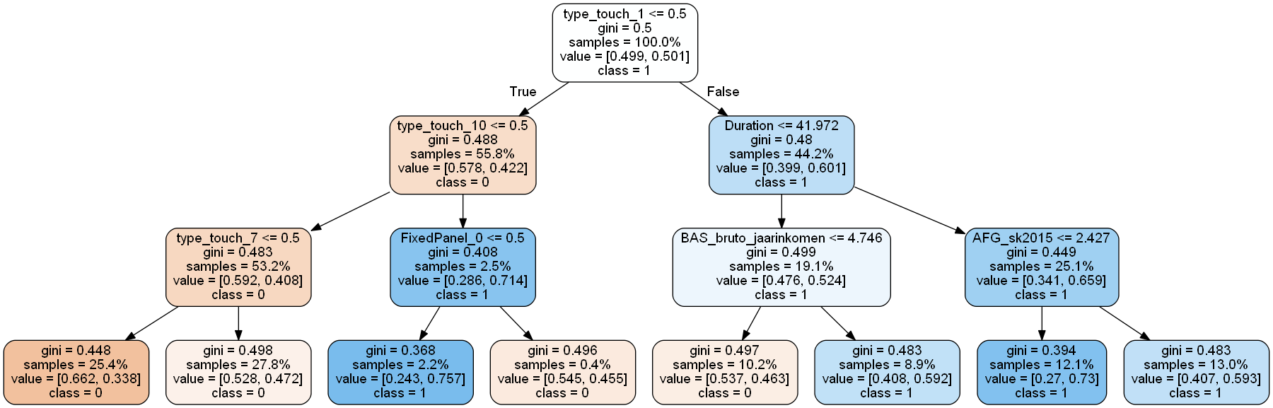
Decision Tree after over sampling

Slide 29
Clustering -couldn’t apply
The given data is seen to be performing very poorly with respect to clustering .
The Silhouette measure was found to be very low as 0.22.
Almost all clusters were very much related with other clusters showing similar characteristics.

Slide 30
Conclusion
With the data given, most of the purchases are consumer initiated conversions(CIC) rather than Firm-initiated conversions(FIC).
After getting model , it can be seen that hardly 2.2% of sample only falls under FIC conversions and yes the probability is higher compared to other leaflets(upto 75%).
Advertising can be a reason for more number of CIC’s i.e more users have some impact on what they see rather than they exploring themselves.
With respect to present data investment can be diverted to other areas like audio and visual type to increase marketing rather than on FIC

Slide 31
THANK YOU

